Slide 1
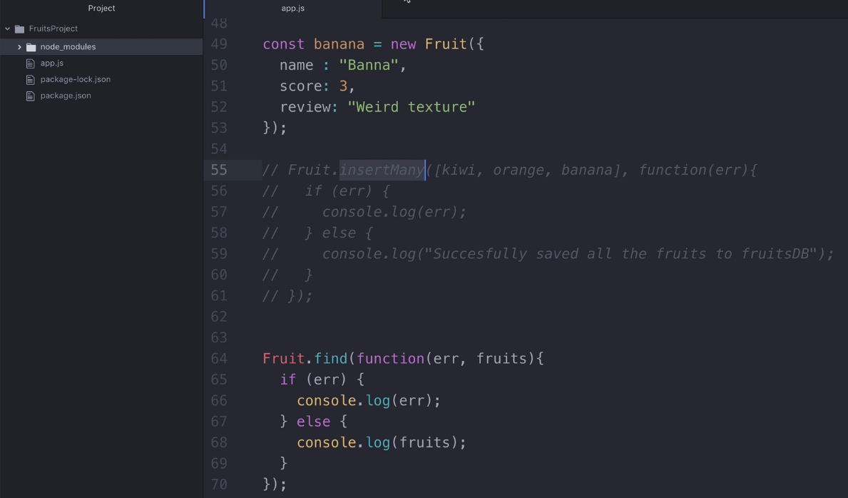
Find documents from collection

Slide 2
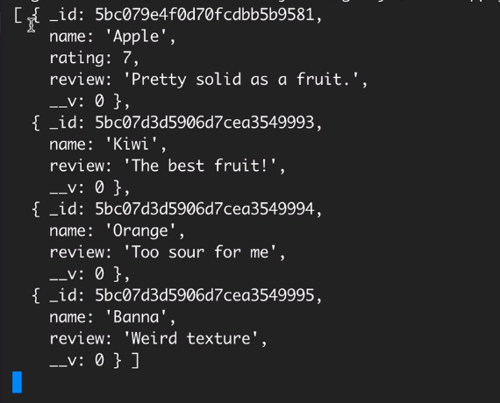
Run app.js using command node app.js.
We can see all the fruits documents one by one. Notice: We are getting answer as array of objects. Suppose if we want to see only Fruit names then how to find it?

Slide 3
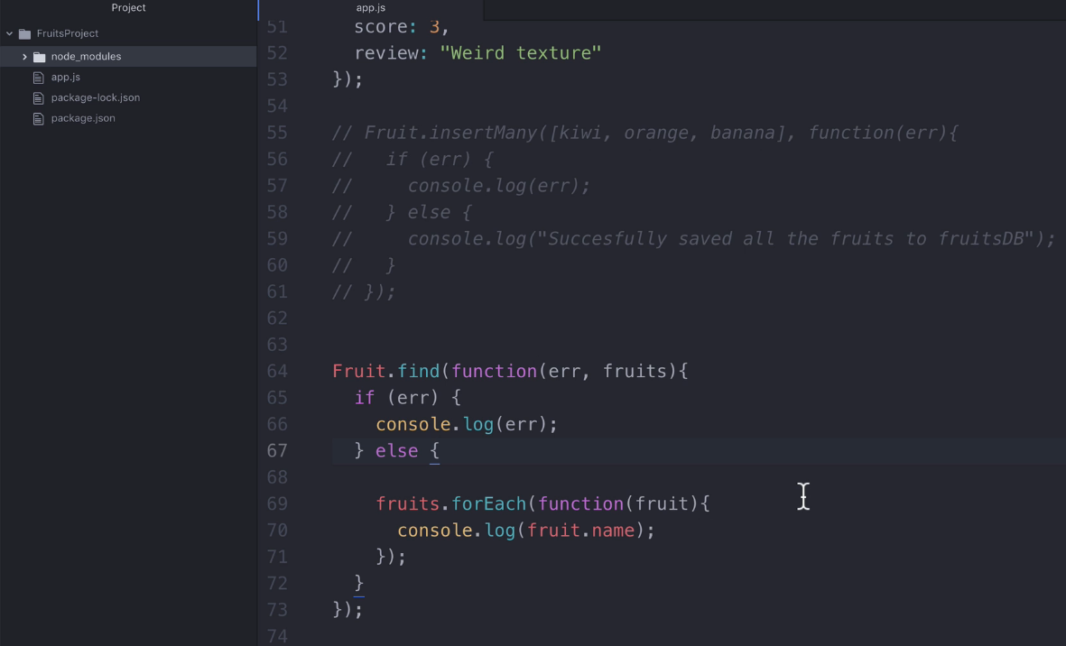
Find query with looping statement to find individual item.

Slide 4
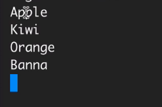
Run app.js using command node app.js.
Now we can see only Fruit names.

Slide 5
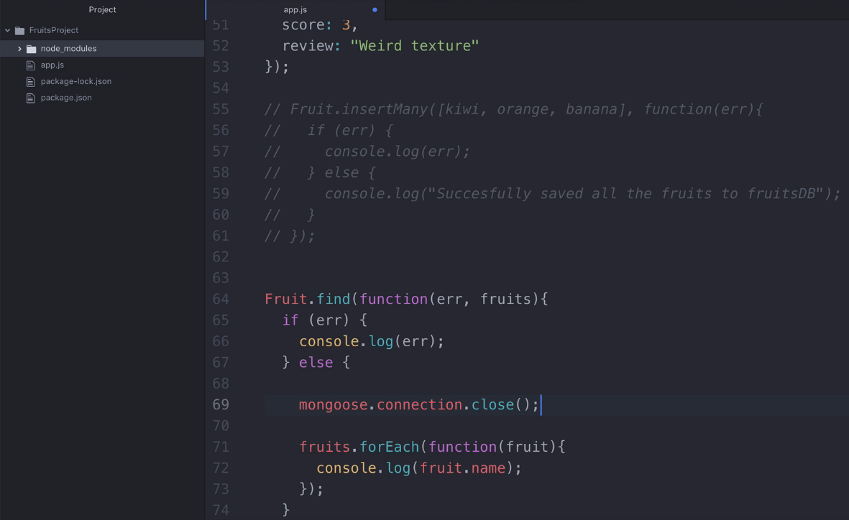
It is a good practice to close mongo DB connection after last task.

Slide 6
Notice:
If we close mongo DB connection properly
then your node application stops after completing last task automatically.
So we don’t want to use Ctrl+c every time to stop node application.

Slide 7
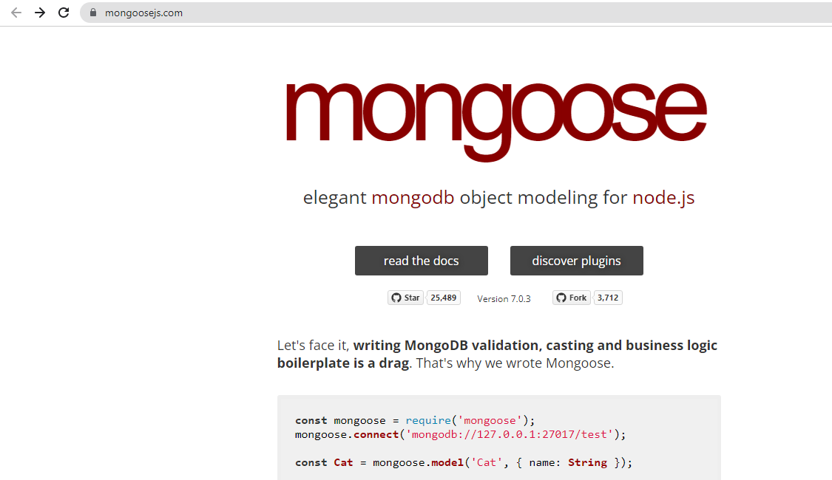
Mongoose Validation

Slide 8
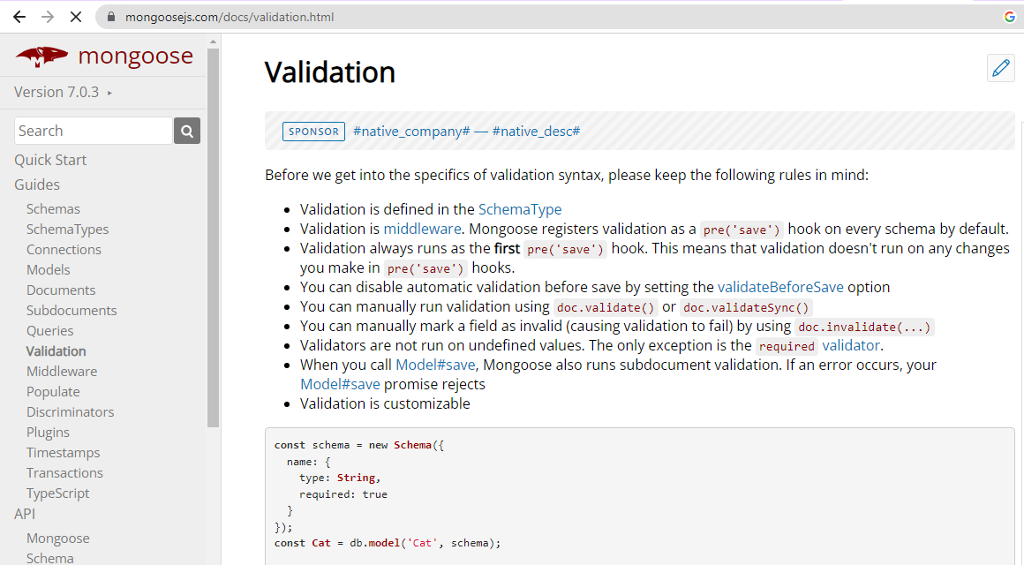

Slide 9
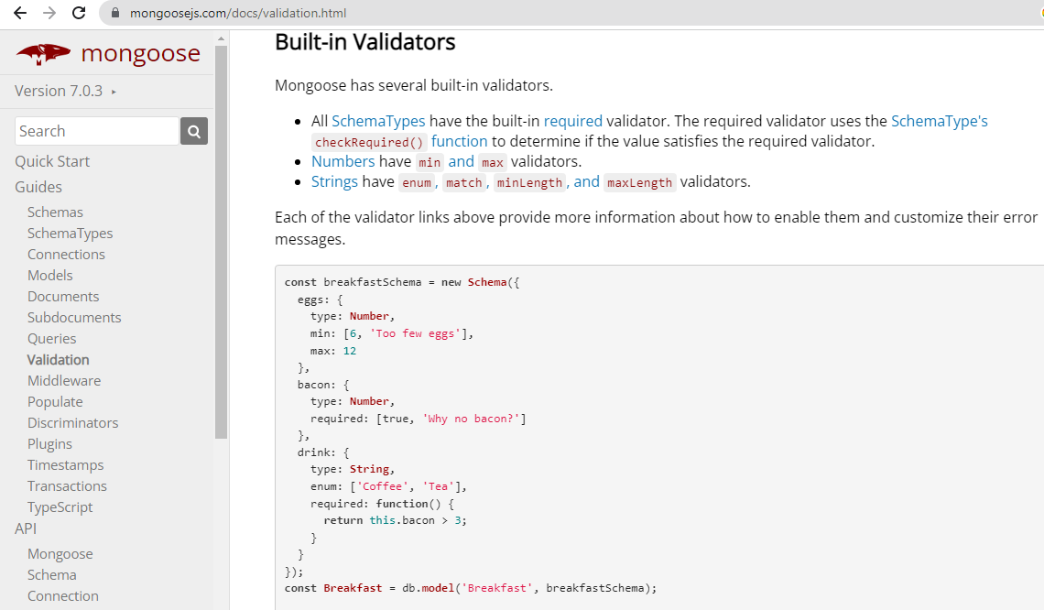

Slide 10
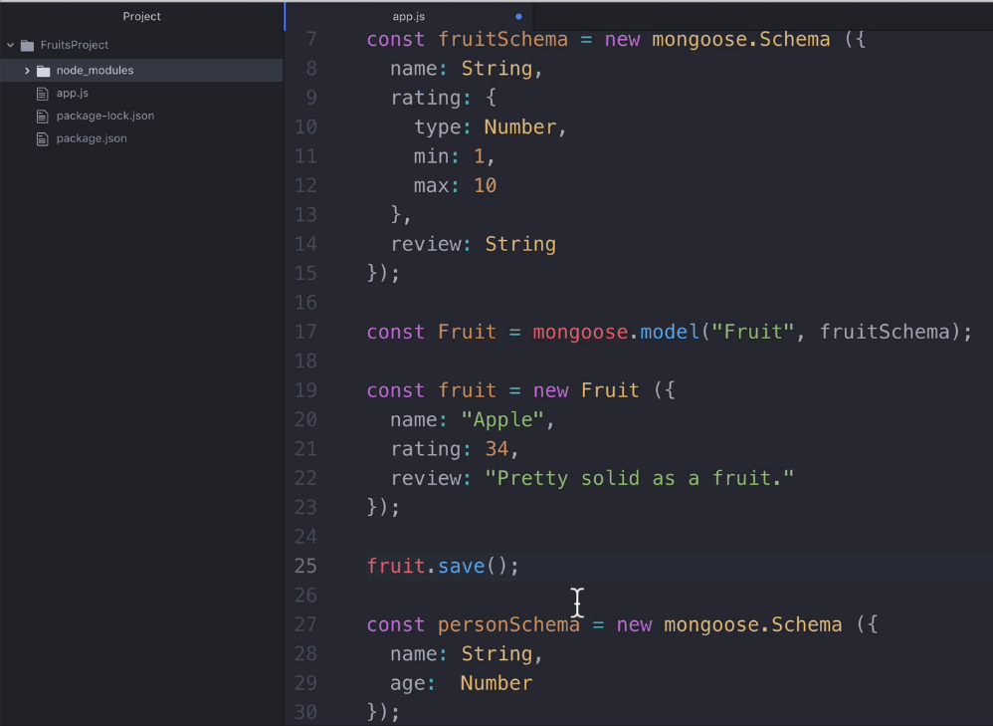
Applying validation at app.js file – min , max

Slide 11
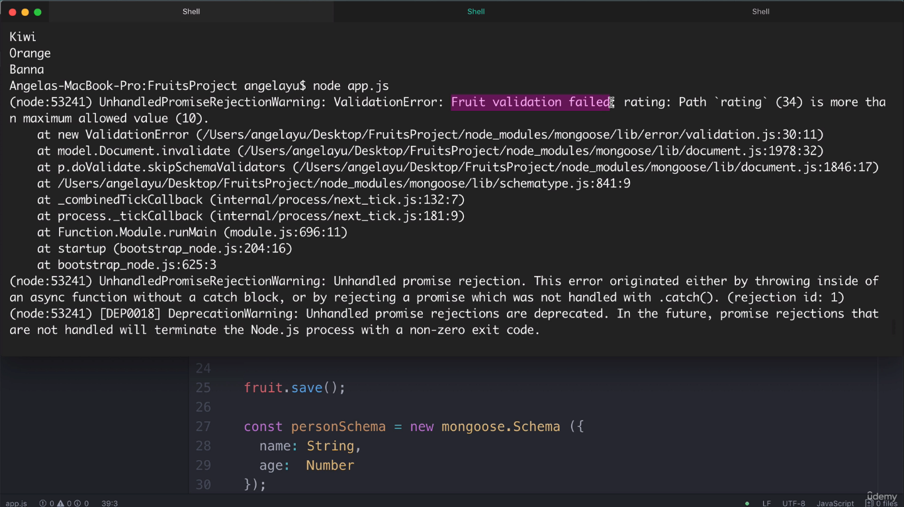
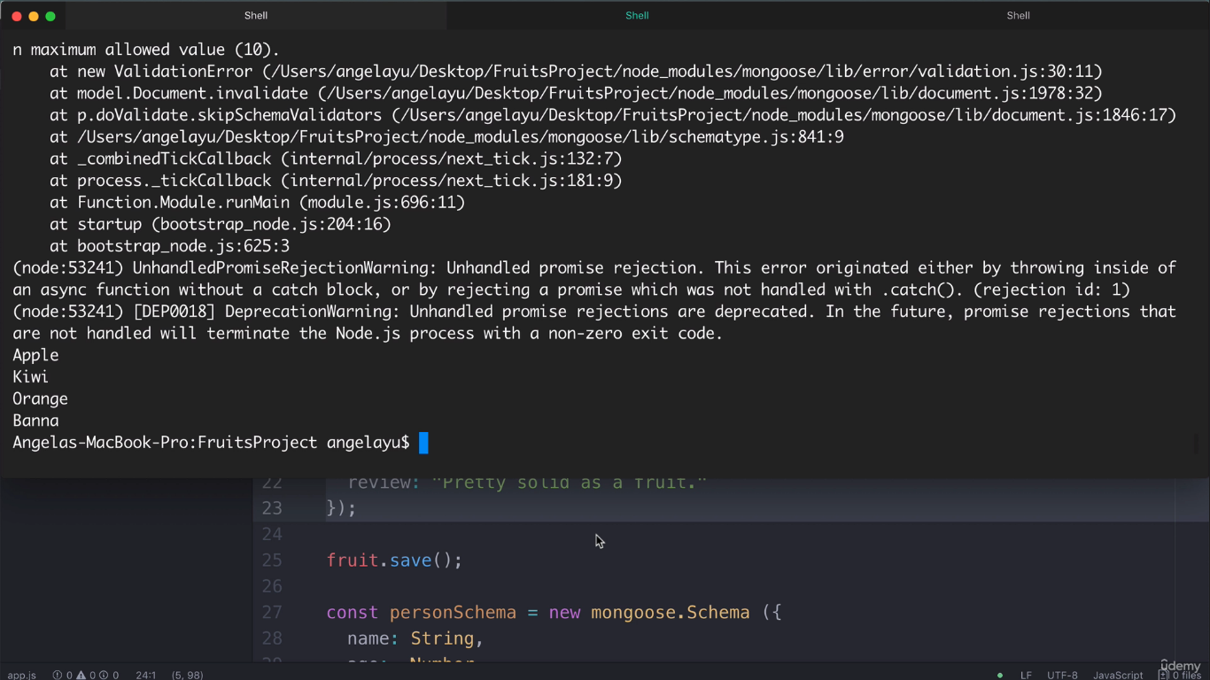
Run app.js using command node app.js.
Now we can see validation error and its error description.
Notice: Apple is not added second time due to error.

Slide 12
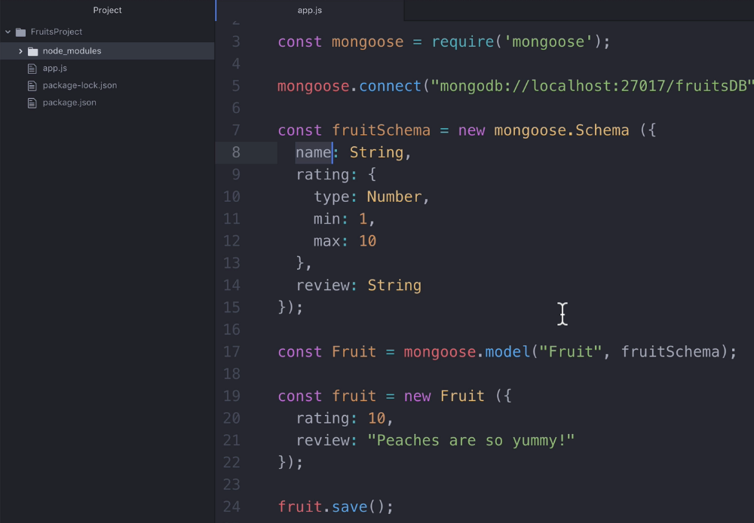
Is it right to add fruit information without fruit name ? How to
Stop adding fruit information without fruit name?

Slide 13
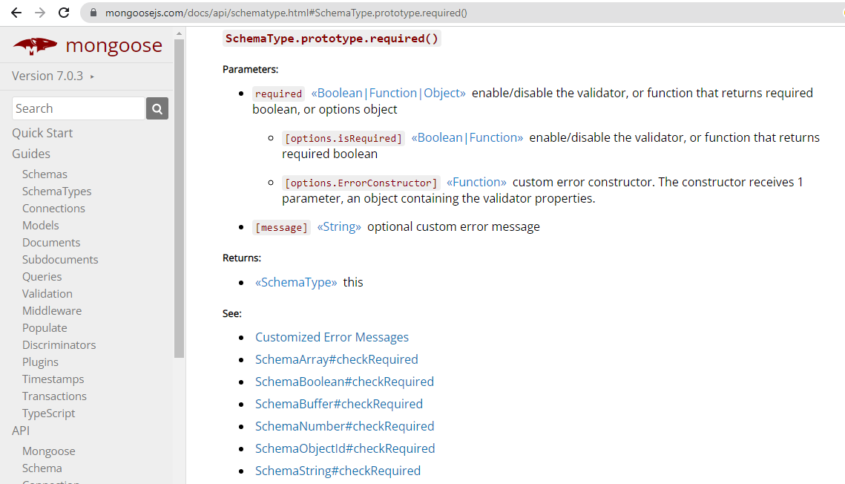

Slide 14
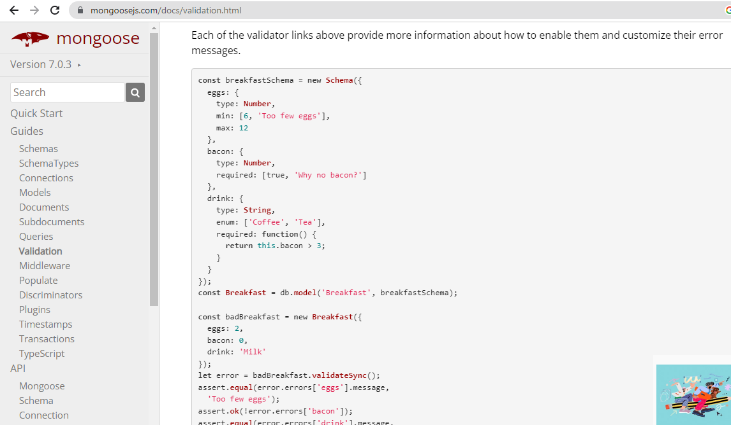

Slide 15
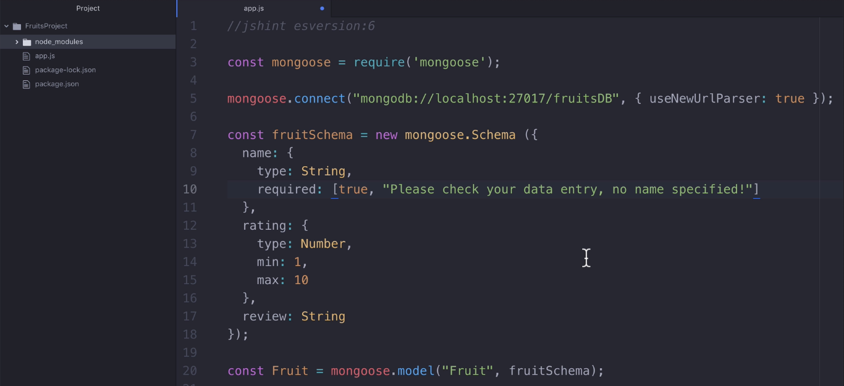
Applying validation at app.js file – required

Slide 16
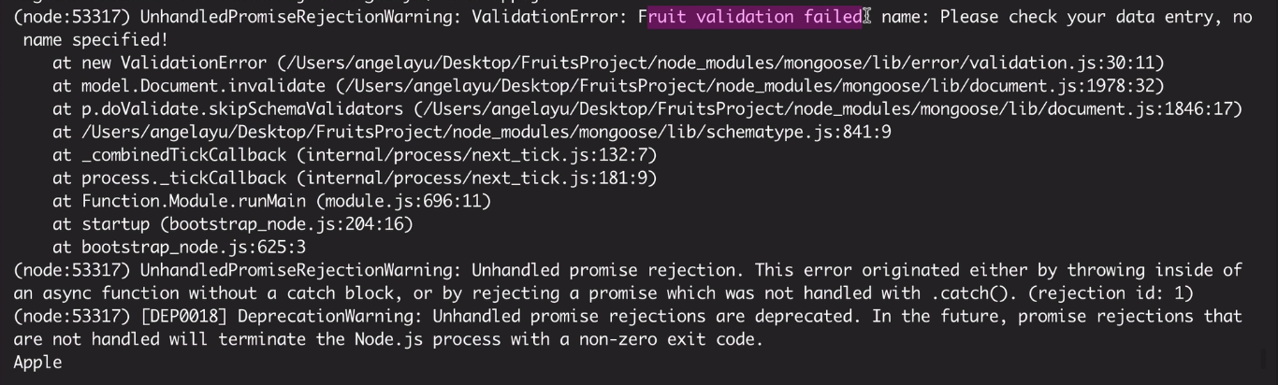
Run app.js using command node app.js.
Now we can see validation error and its error description.
Notice: Custom Error Message is displayed.

Slide 17
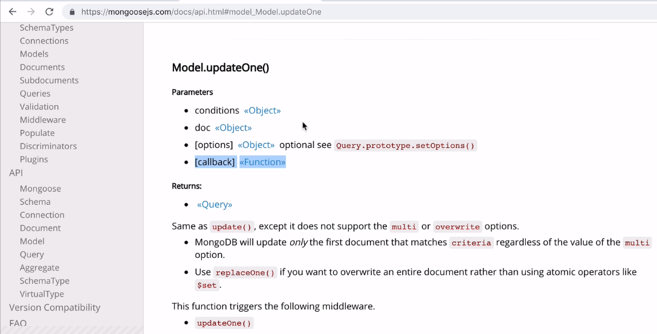
Update Process : It requires three parameters.

Slide 18
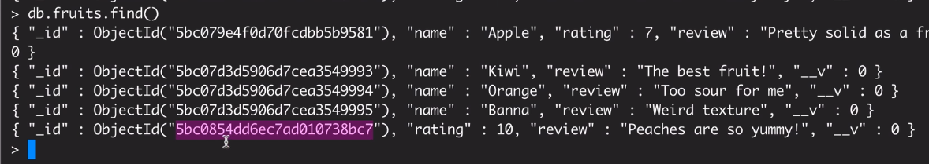
Update Process : We are going to add fruit name of selected
object_id below

Slide 19
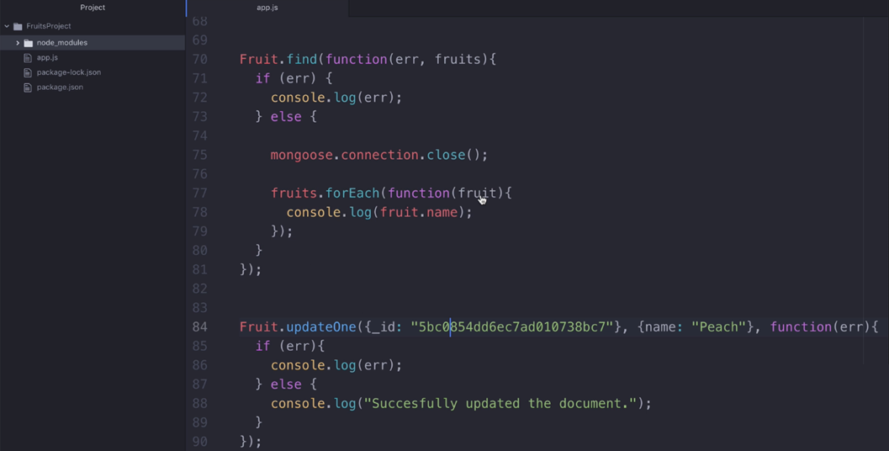
Update Process : We are going to add fruit name of selected
object_id below using updateOne() method

Slide 20
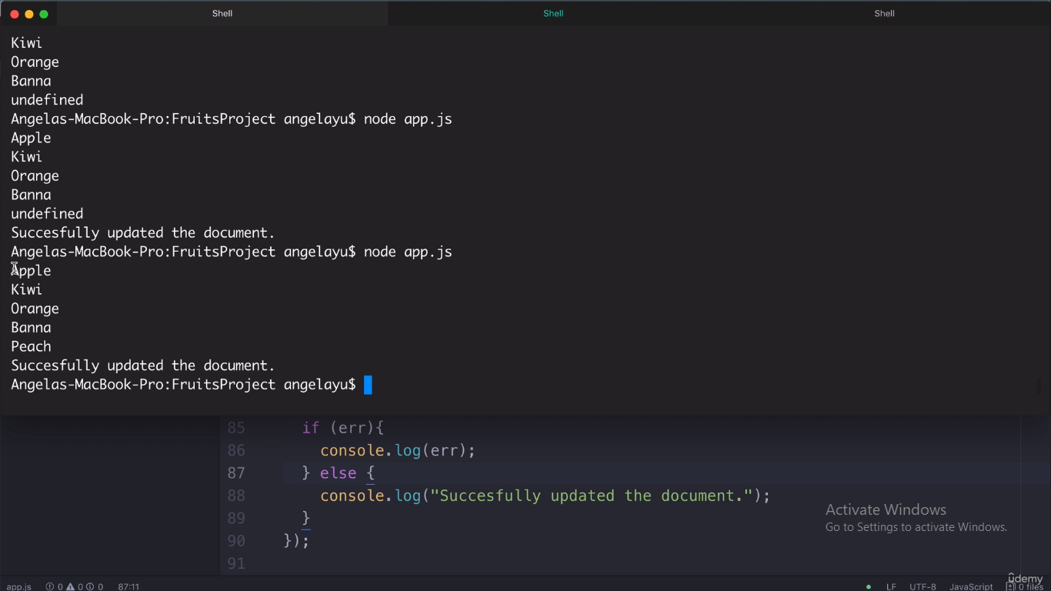
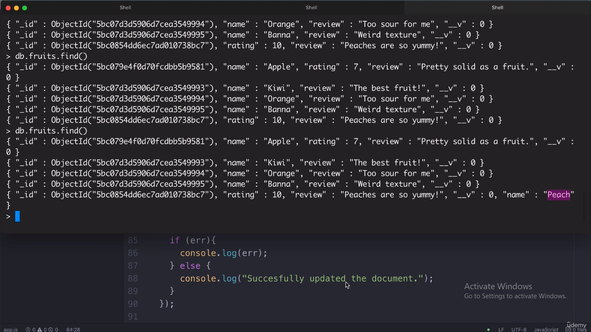
Output at node Application
Output at MongoDB Shell

Slide 21
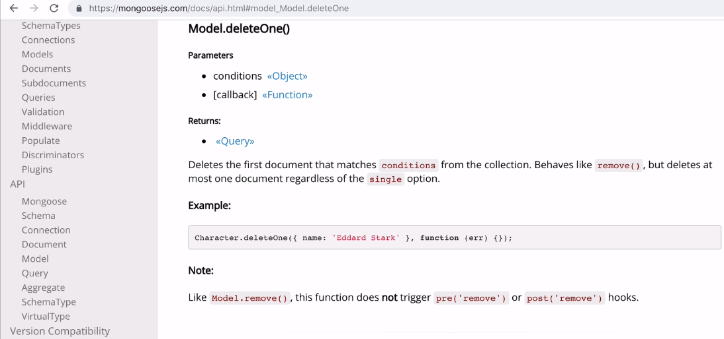
Delete Process : It requires two parameters.

Slide 22
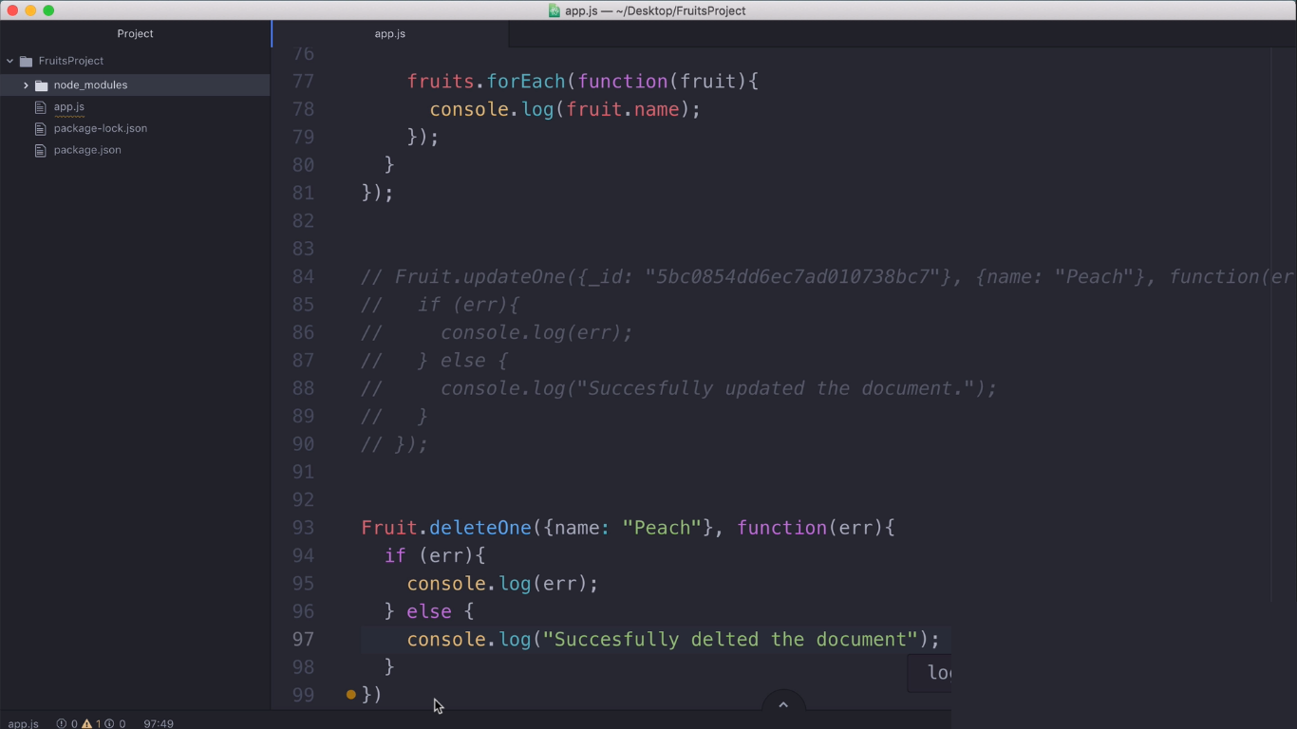
Delete Process : We are going to delete a particular fruit name using deleteOne() method

Slide 23
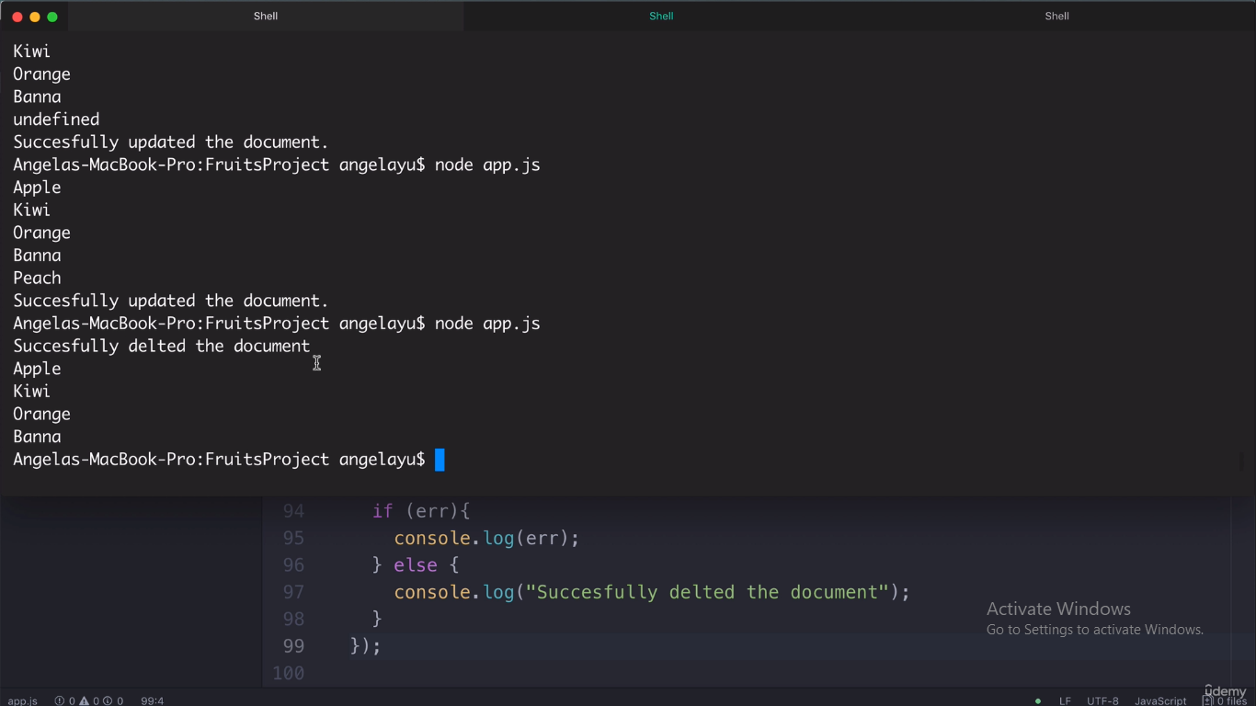
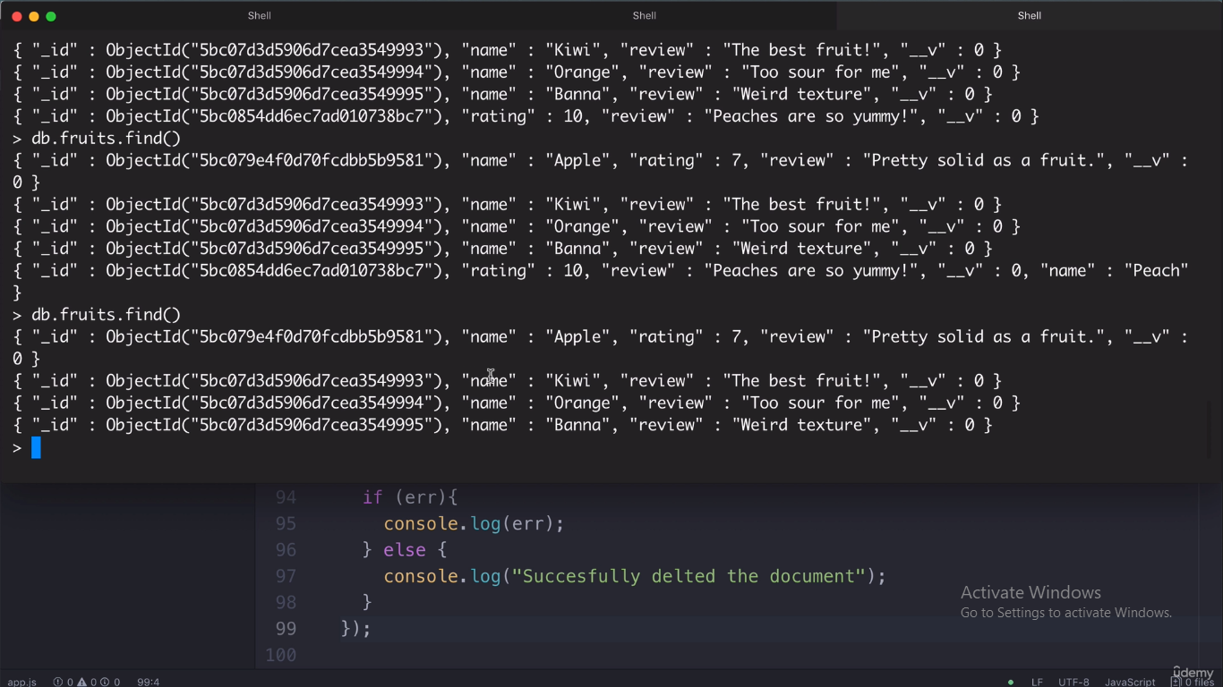
Output at node Application
Output at MongoDB Shell

Slide 24
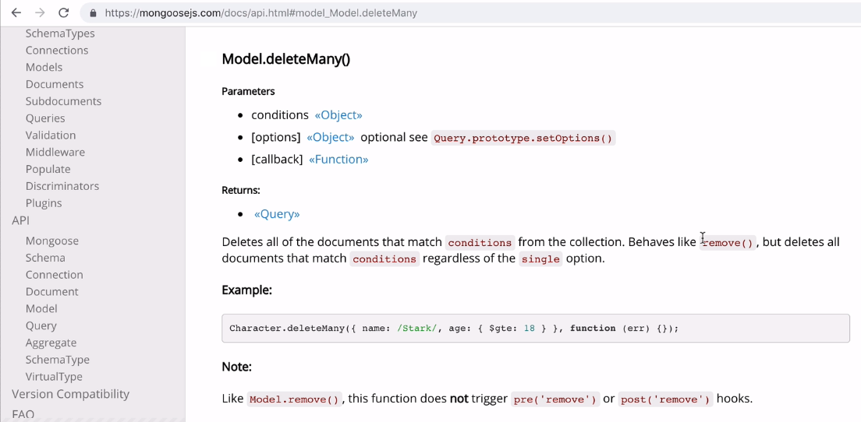
Delete Many Syntax : It requires three parameters.
It is used to clear-out the collection.

Slide 25
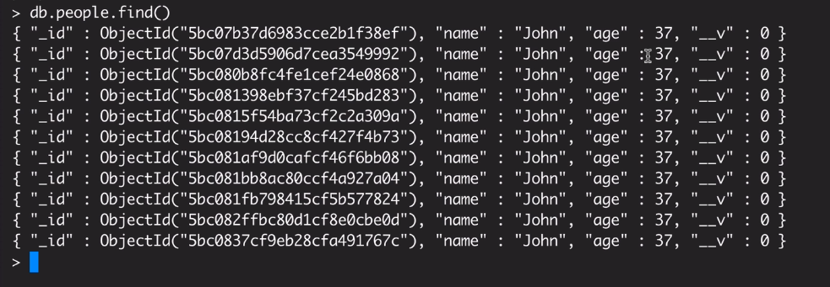

Slide 26
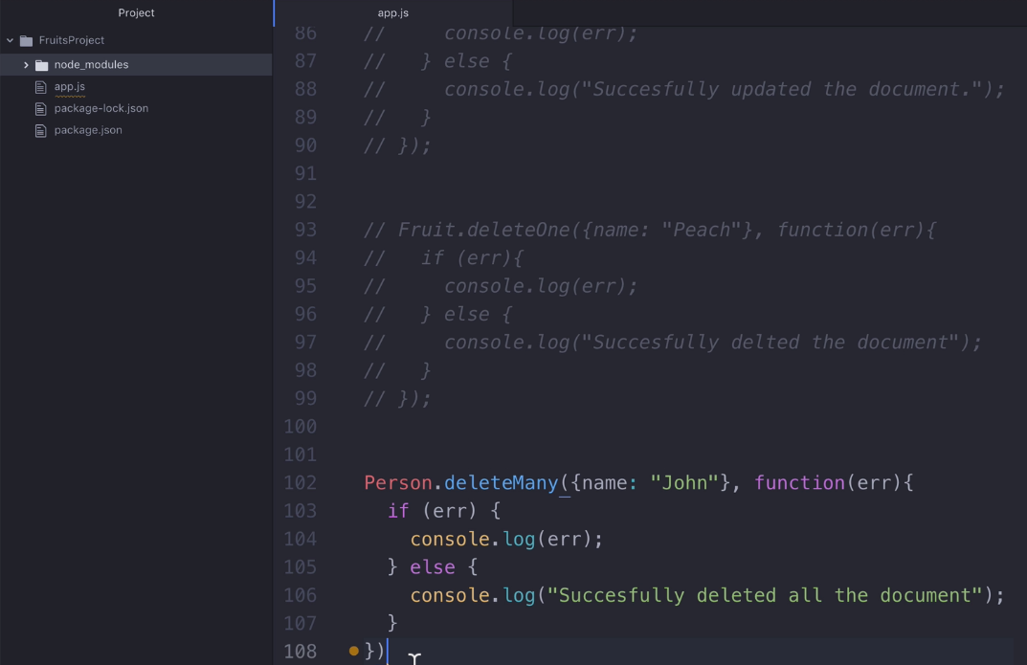

Slide 27
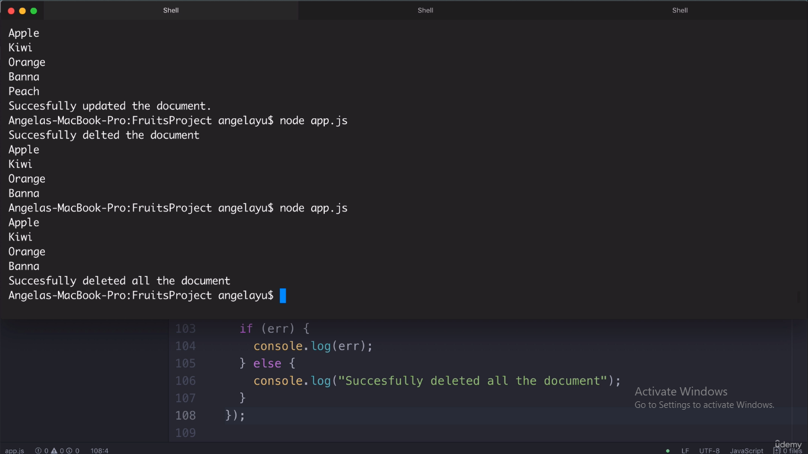
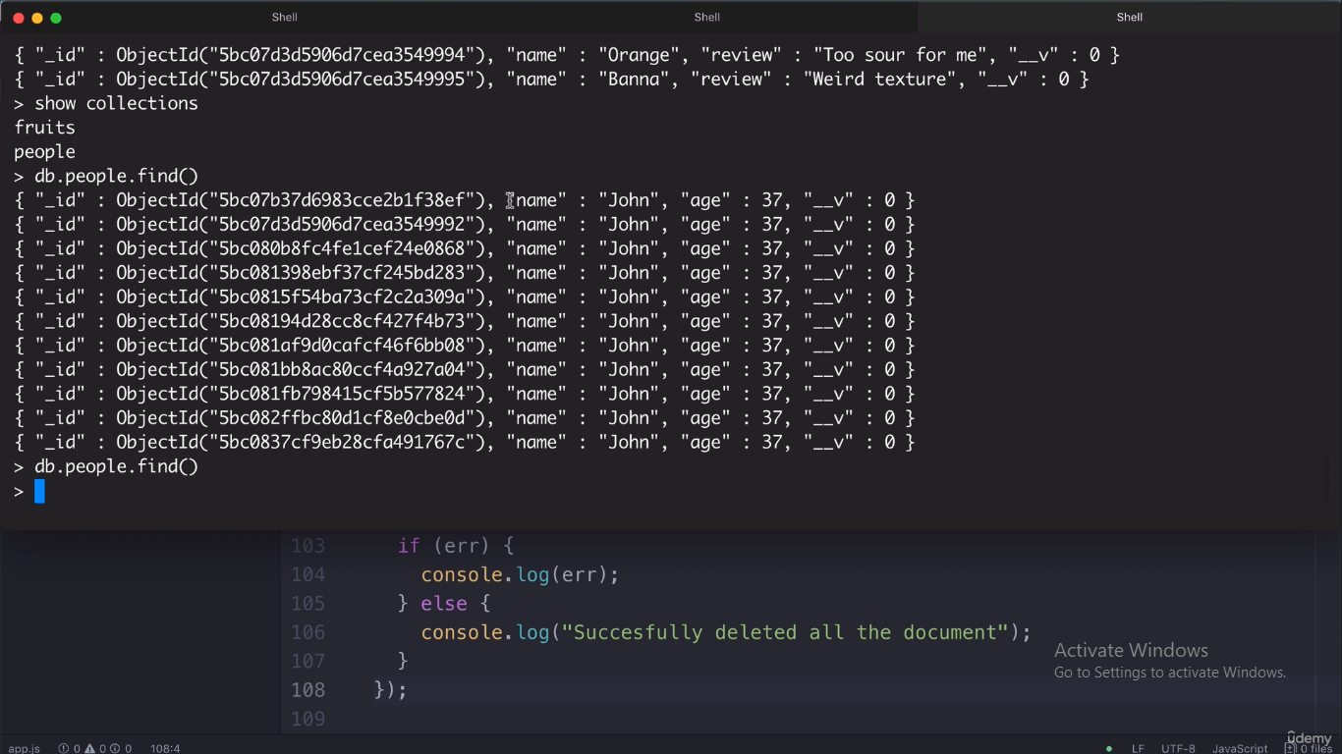
Output at node Application
Output at MongoDB Shell

Slide 28
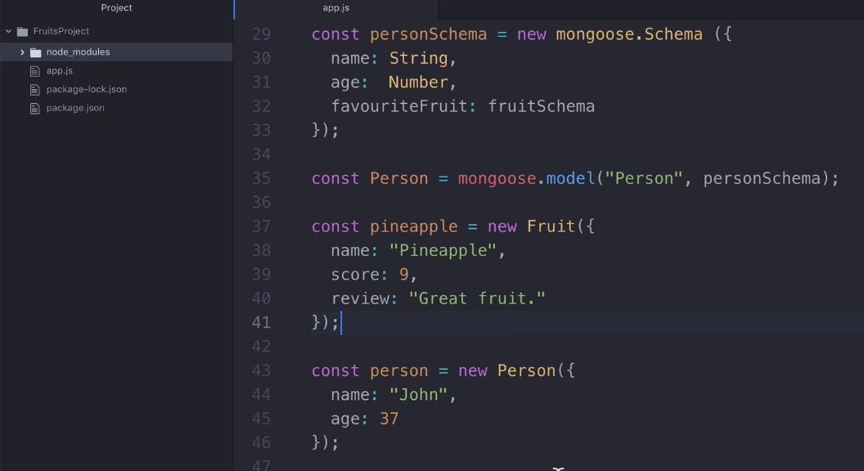
Creating Relations: Adding new field favouriteFruit at personSchema

Slide 29
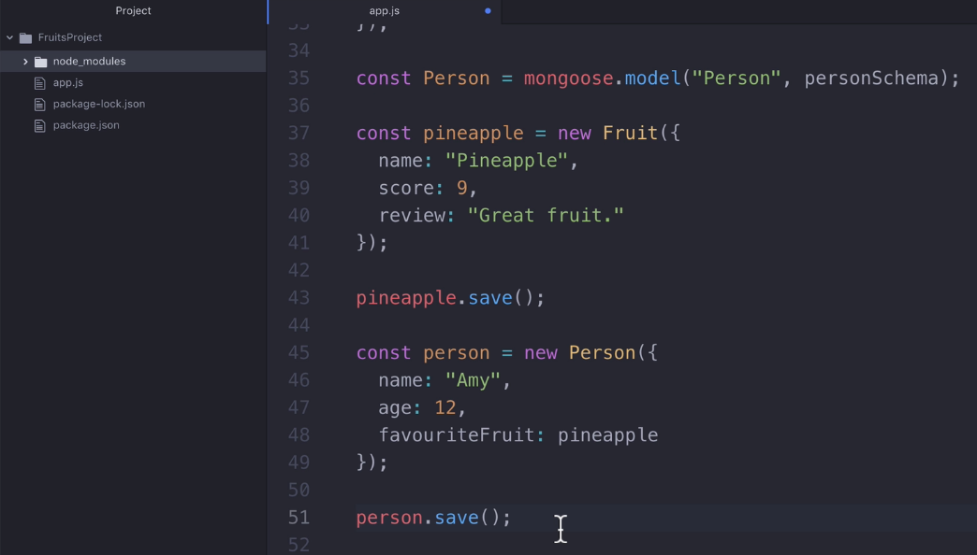
Inserting pineapple fruit at Fruit Collection,and new person Amy at Person Collection

Slide 30
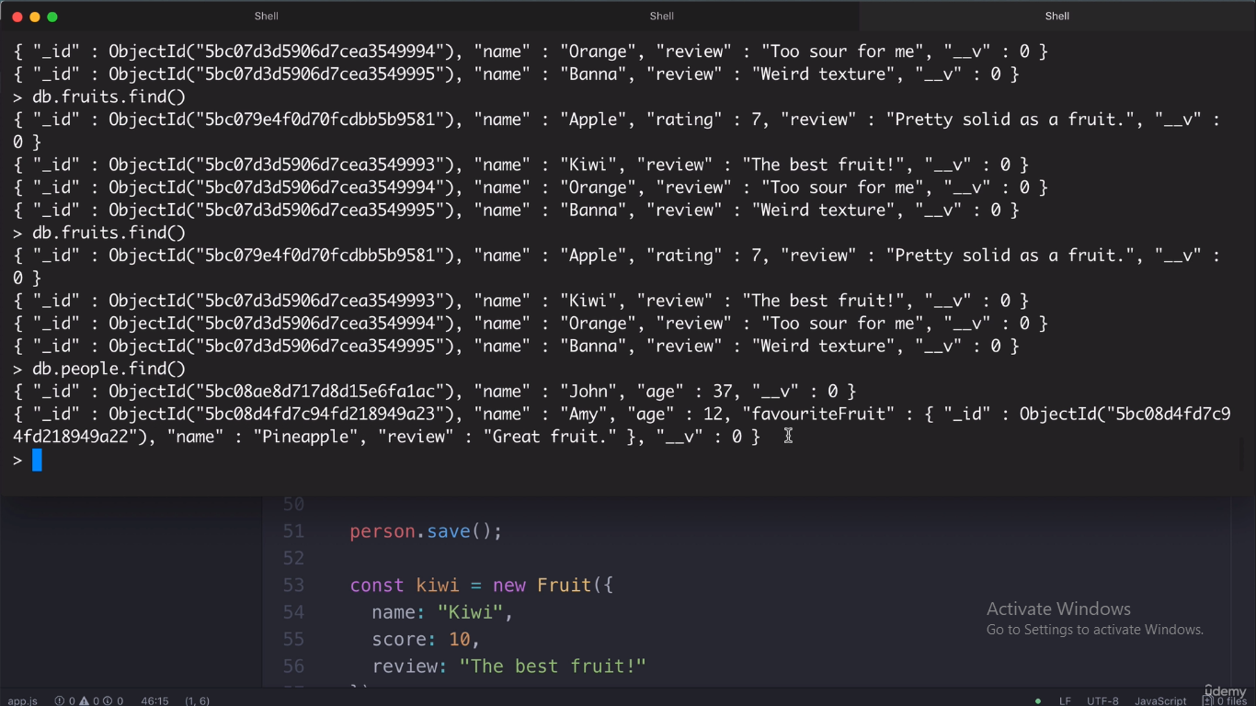
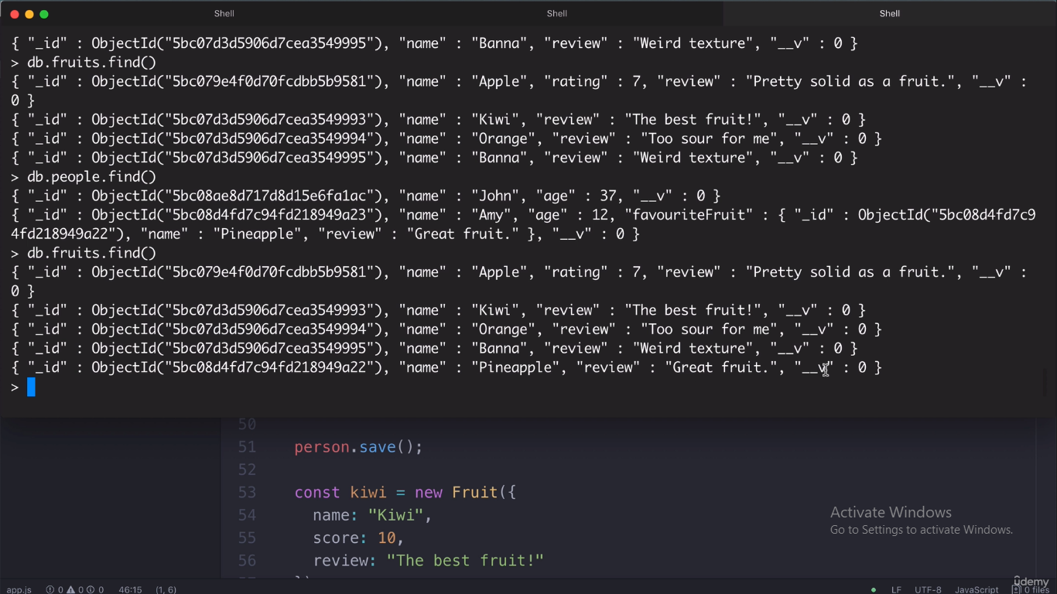
Output at MongoDB Shell
Like Amy add favouriteFruit to John

Slide 31
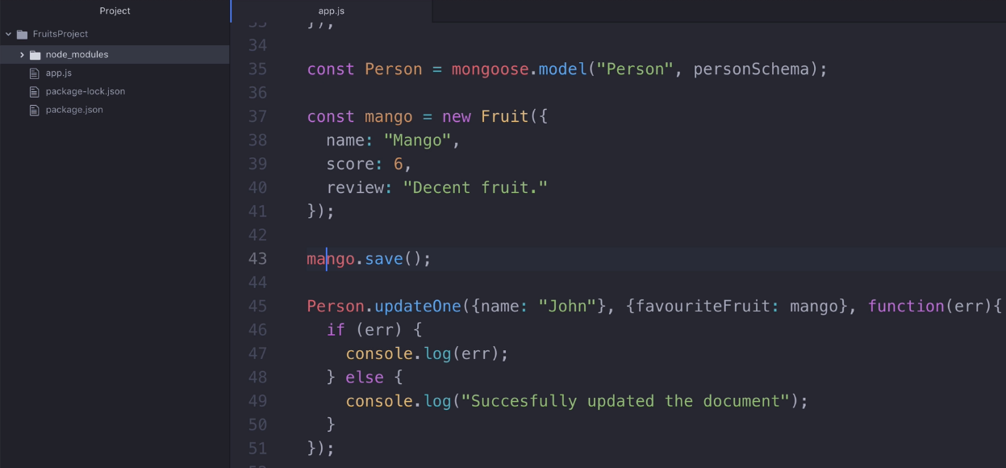
Inserting mango fruit at Fruit Collection, and updating a person John at Person Collection

Slide 32
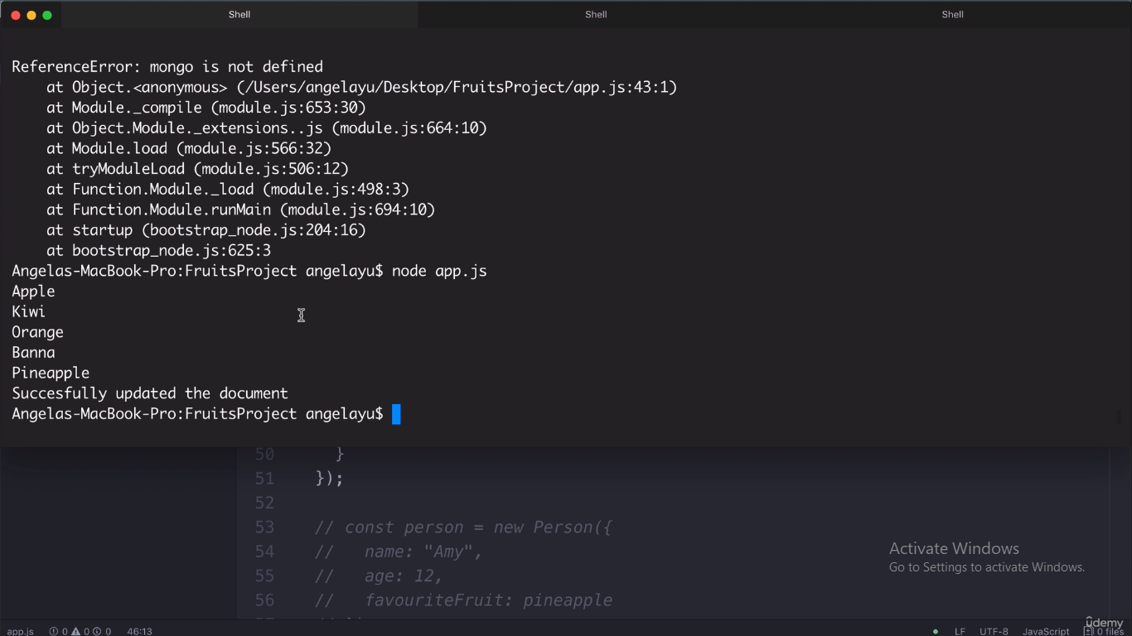
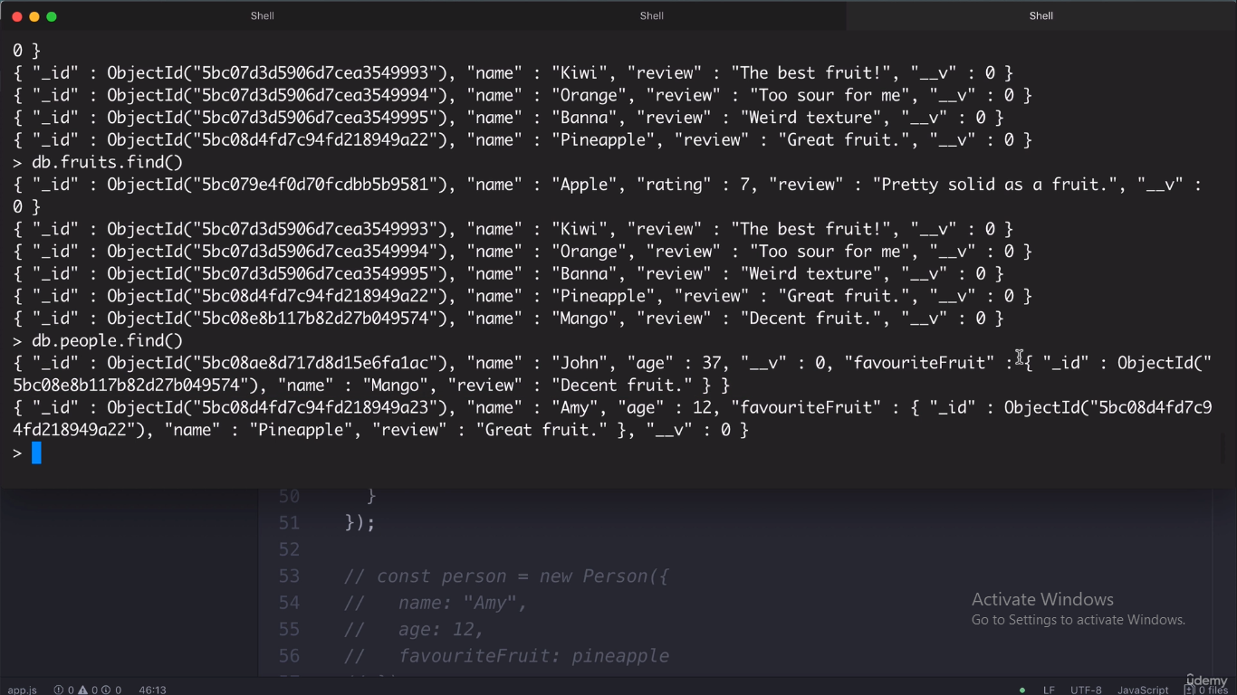
Output at node Application
Output at MongoDB Shell

Slide 33
Coding Activity:
Upload your project folder worked with mongoose package &
necessary Screen shots like Insert, Find, Update, Delete and
Adding Relations in both Node Application and
MongoDB Shell.

